Slide 1
Punnett Squares and DNA
biological data science
spring 2019

Slide 2
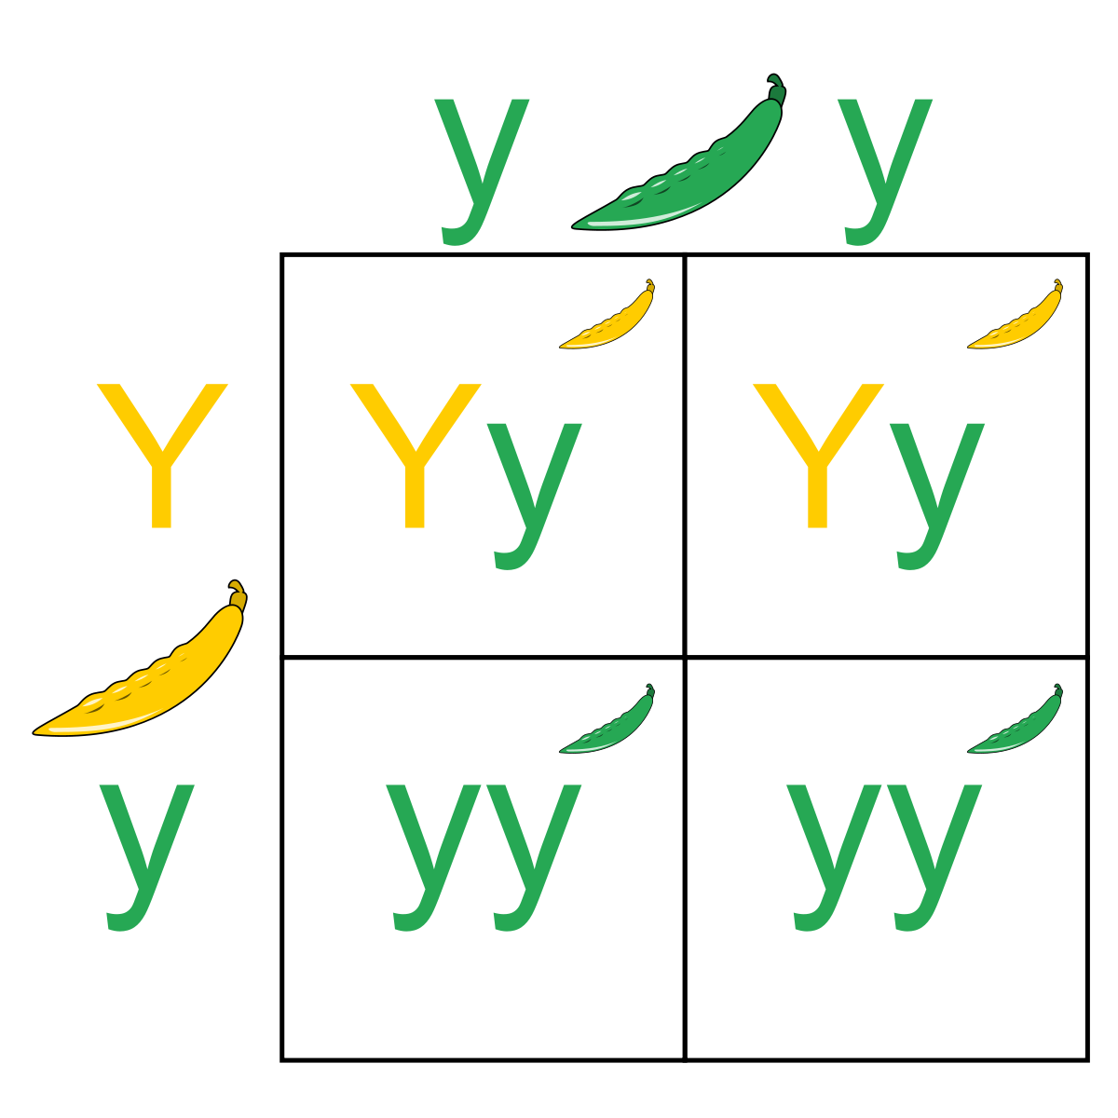
Monohybrid Punnett Square

Slide 3
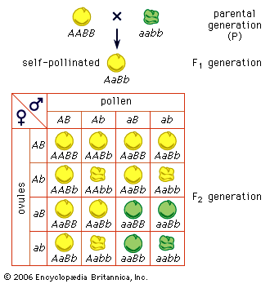
Dihybrid Punnett Square

Slide 4
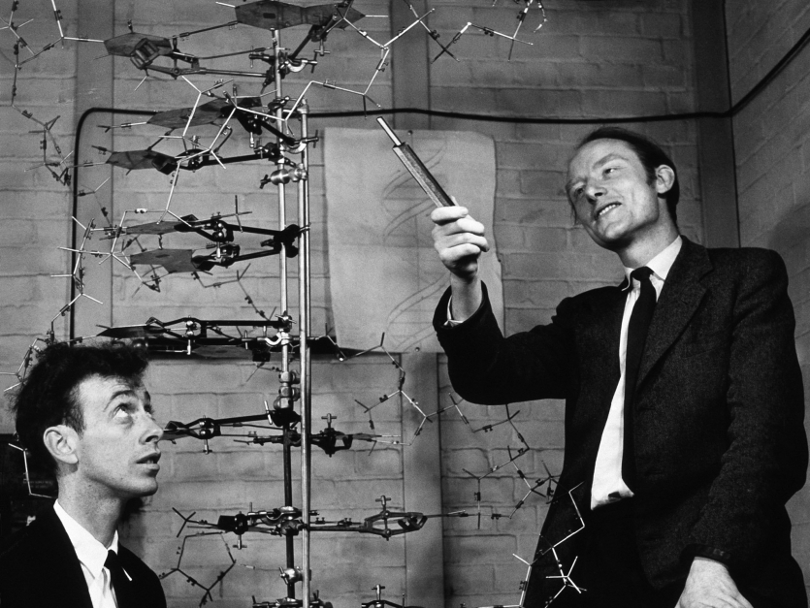
DNA
Who discovered the structure of DNA?
James Watson and Francis Crick?

Slide 5
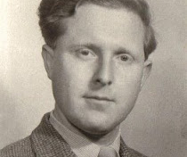

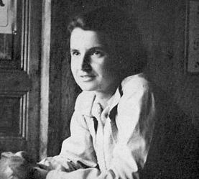
Rosalind Franklin and Raymond Gosling
Gosling was Franklin’s PhD student
They used x-ray crystallography to investigate the molecule

Slide 6
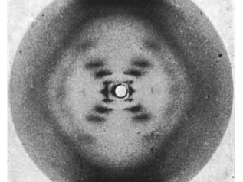
Photo 51
Key for understanding the structure of DNA
Francis and Crick were given unauthorized access to this photo

Slide 7
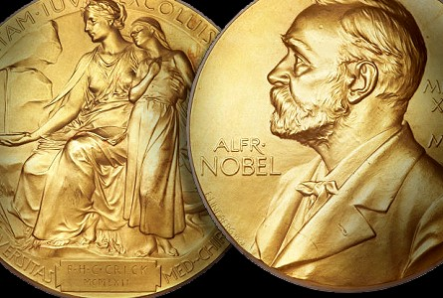
1962 Nobel Prize
Awarded to Francis and Crick
Rosalind Franklin died from ovarian cancer four years earlier at the age of 37

Slide 8
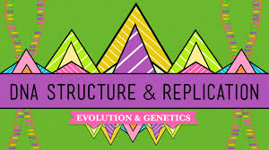
Hank’s DNA Structure and Replication
https://www.youtube.com/watch?v=8kK2zwjRV0M&list=PL3EED4C1D684D3ADF&index=10

Slide 9
DNA
A polymer (many copies of similar units bonded together)
Double-stranded
One strand runs from 5’ to 3’, the other 3’ to 5’
Base pairs: A bonds to T, C bonds to G
Unzip the double helix to replicate
A primase is needed to begin the replication
Exposed nucleotides dictate the correct pattern

Slide 10
RNA
Three differences from DNA:
Single stranded
U instead of T
Different sugar in backbone

